Slide 1
2026 Summer Break FTL Study
Basic Lecture
2026.08.04
Presentation by Choi, Gunhee
choi_gunhee@dankook.ac.kr

Slide 2
FEMU
FIO
Filebench
논문 재현

Slide 3
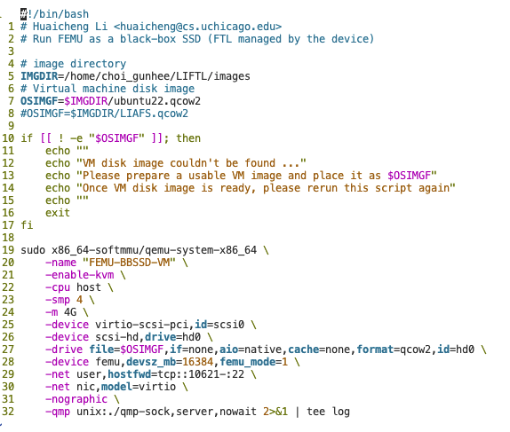
1. FEMU
FEMU 기반 논문 git
run-blockbox.sh
https://github.com/MoatLab/FEMU
https://github.com/astlxmu/LearnedFTL
https://github.com/theXiaofu/Seg-FTL
devsz_mb : 용량
net user,hostfwd=tcp::10621-:22 : 포트포워딩

Slide 4
2. FIO
Link : https://fio.readthedocs.io/en/latest/fio_doc.html
Install
sudo apt-get update sudo apt-get install -y fio
Command
# 1G 순차 쓰기 FIO 명령어 sudo fio --name=seq_write_1G \ --filename=/dev/nvme0n1 \ --ioengine=libaio \ --iodepth=32 \ --rw=write \ --bs=128k \ --direct=1 \ --size=1G \ --numjobs=1 \ --group_reporting

Slide 5
2. FIO
Link : https://fio.readthedocs.io/en/latest/fio_doc.html
Install
sudo apt-get update sudo apt-get install -y fio
Basic FIO GC Experiment
sudo fio --name=fill_half \
--filename=/dev/nvme0n1 \
--ioengine=libaio \
--iodepth=32 \
--rw=write \
--bs=128k \
--direct=1 \
--size=10G \
--numjobs=1 \
--group_reporting
sudo fio --name=force_gc \
--filename=/dev/nvme0n1 \
--ioengine=libaio \
--iodepth=64 \
--rw=randwrite \
--bs=4k \
--direct=1 \
--size=10G \
--time_based=1 \
--runtime=300 \
--numjobs=4 \
--group_reporting

Slide 6
2. FIO
Link : https://fio.readthedocs.io/en/latest/fio_doc.html
Install
sudo apt-get update sudo apt-get install -y fio
Basic FIO GC Experiment
[global]
filename=/dev/nvme0n1
ioengine=libaio
direct=1
group_reporting
size=10G # 16GB SSD 중 10GB(약 62.5%) 구간만 타겟팅
# Step 1: 디스크의 10GB 구간을 순차 데이터로 채움 (Pre-conditioning)
[precondition]
rw=write
bs=128k
iodepth=32
numjobs=1
# Step 2: 동일한 10GB 구간에 4KB 랜덤 쓰기를 수행하여 GC 강제 유발
[trigger_gc]
stonewall # 앞의 [precondition] 작업이 완료된 후 실행
rw=randwrite
bs=4k
iodepth=64
numjobs=4 # 동시다발적인 IO 요청으로 FTL 큐 압박
time_based=1
runtime=300 # 300초 동안 10GB LBA 구간 내에서 지속적인 덮어쓰기 발생
sudo fio gc_test_16g.fio

Slide 7
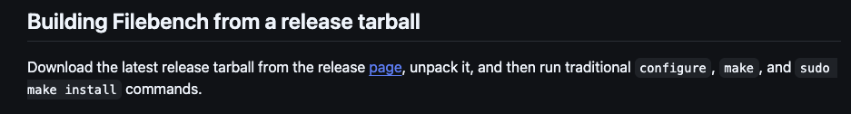
3. Filebench
Link : https://github.com/filebench/filebench
Link : https://github.com/filebench/filebench/releases
Install
(중요) sudo sysctl -w kernel.randomize_va_space=0
FS format
sudo mkfs.ext4 /dev/nvme0n1
sudo mkdir -p /mnt/femu_nvme
sudo mount -o noatime /dev/nvme0n1 /mnt/femu_nvme
sudo filebench -f ./my_fileserver.f
set $dir=/tmp
set $nfiles=1000
set $meandirwidth=1000000
set $filesize=cvar(type=cvar-gamma,parameters=mean:16384;gamma:1.5)
set $nthreads=16
set $iosize=1m
set $meanappendsize=16k
define fileset name=bigfileset,path=$dir,size=$filesize,entries=$nfiles,dirwidth=$meandirwidth,prealloc=80
define process name=filereader,instances=1
{
thread name=filereaderthread,memsize=10m,instances=$nthreads
{
flowop deletefile name=deletefile1,filesetname=bigfileset
flowop createfile name=createfile2,filesetname=bigfileset,fd=1
flowop appendfilerand name=appendfilerand2,iosize=$meanappendsize,fd=1
flowop fsync name=fsyncfile2,fd=1
flowop closefile name=closefile2,fd=1
flowop openfile name=openfile3,filesetname=bigfileset,fd=1
flowop readwholefile name=readfile3,fd=1,iosize=$iosize
flowop appendfilerand name=appendfilerand3,iosize=$meanappendsize,fd=1
flowop fsync name=fsyncfile3,fd=1
flowop closefile name=closefile3,fd=1
flowop openfile name=openfile4,filesetname=bigfileset,fd=1
flowop readwholefile name=readfile4,fd=1,iosize=$iosize
flowop closefile name=closefile4,fd=1
}
}
echo "Varmail Version 3.0 personality successfully loaded"
run 60

Slide 8
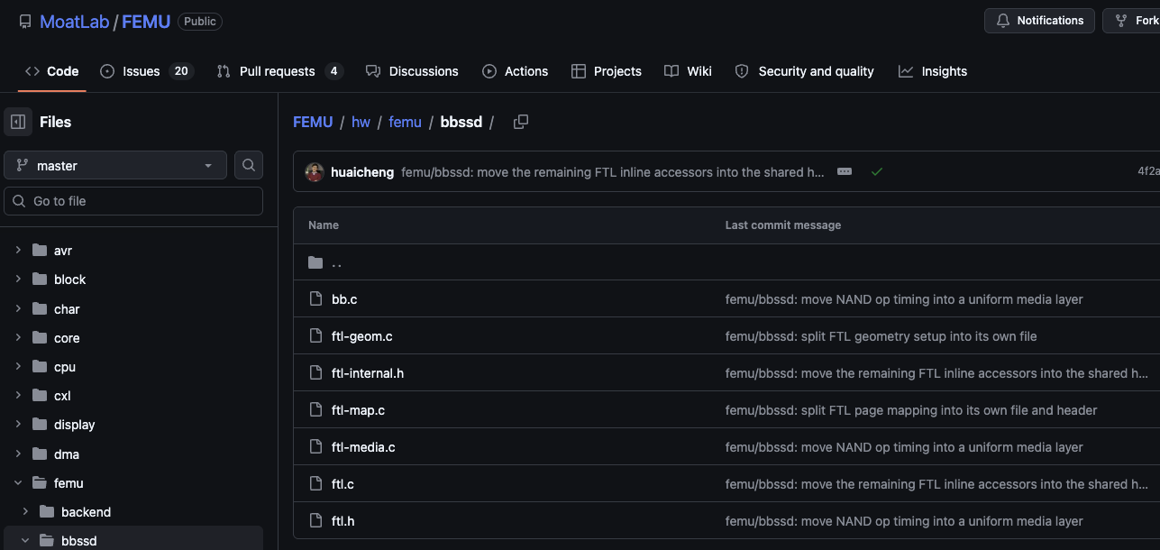
4. 할 일
원하는 논문 한편의 실험 결과 일부를 재현해봅시다.
FEMU 소스코드 분석
원하는 실험 진행
논문 발표
다음 주부터
1팀은 1~3번 진행 발표
2팀 논문 발표
번갈아가면서 진행

Slide 9
2026 여름 방학 FTL Study
Basic Lecture
2026.07.21
Presentation by Choi, Gunhee
choi_gunhee@dankook.ac.kr
Thank you!
Q & A ?

